Slide 1

BSRA
Technical Consultant & Services

Slide 2

Vision Statement
“To provide innovative technical solutions, consultation to empower businesses and organization; maintaining efficiency, trust, integrity, cost-effectiveness and customer satisfaction.”

Slide 3

WE ARE
A firm that combines extensive experience & knowledge of our senior leaders with diverse domain expertise required in complex system integration projects in multiple domains.
An integrated value-added solution provider offering cost effective and state of art consultancy & services in
  IT
  Communication
  Healthcare
  E Learning
  Cyber Security
Experts at perceiving customer’s business requirements, their culture and vision, enabling us to offer customer oriented highly reliable solutions.

Slide 4

Advantage with BSRA
Technology
Time
Our endeavour is to ensure we provide our customers with the latest technology and business processes to provide state-of-the-art solutions
  We aim to deliver well researched , time bound services and solutions as per the customer/project timelines and milestones
BEST OPTION
Security
Cost
Your data security is BSRA’s priority. Our anti-theft and anti-data-loss strategies follow the best security practices to ensure that your data is always safe
  Our services are designed with cost-effectiveness as our priority while keeping our operational costs optimized to align with our client’s budget.

Slide 5






SEGMENTS WE CATER
Business Segment
Education
BEST OPTION
Telecommunication
Enterprise
Auto
& Transportation
Health Care
Residential

Slide 6
PROJECT CONSULTANCY
PROJECT CONSULTANCY
Command Control & BPO Contact Centres
Smart City Components
Command Control & BPO Contact Centres
Smart City Components
Data Security, Data base & Storage
Project Management
Emergency Response Center
Emergency Response Center
Video Conferencing Solution
Video Conferencing Solution
E-Commerce
Data center and Network Infrastructure
Data center and Network Infrastructure
CCTV Surveillance security
CCTV Surveillance security
E-Learning
Application
E-Learning
Application
OPTION
01
OPTION
01
Web, Desktop, Mobile Application
Data Security, Data base solutions & Storage
Web, Desktop, Mobile Application
Project Management
Cyber Security
Cyber Security

Slide 7


PROGRAM MANAGEMENT
DOCUMENTATION
Program/Project Management
Documentation
  BSRA Technical Consultancy & Services LLP has a pool of certified PMP and IT professionals. We undertake Program/Project management consultancy and implementation process from End to End i.e. formulation stage to Project delivery to the End User as per defined milestones.
  Detailed Project Reports (DPR)
  Bid/RFP/EOI preparation
  User and Training Manuals
  Project documentation e.g. SRS, FRS, HLD, LLD, BCP
  IT infrastructure site survey
  Audit related
  Data Security Related

Slide 8
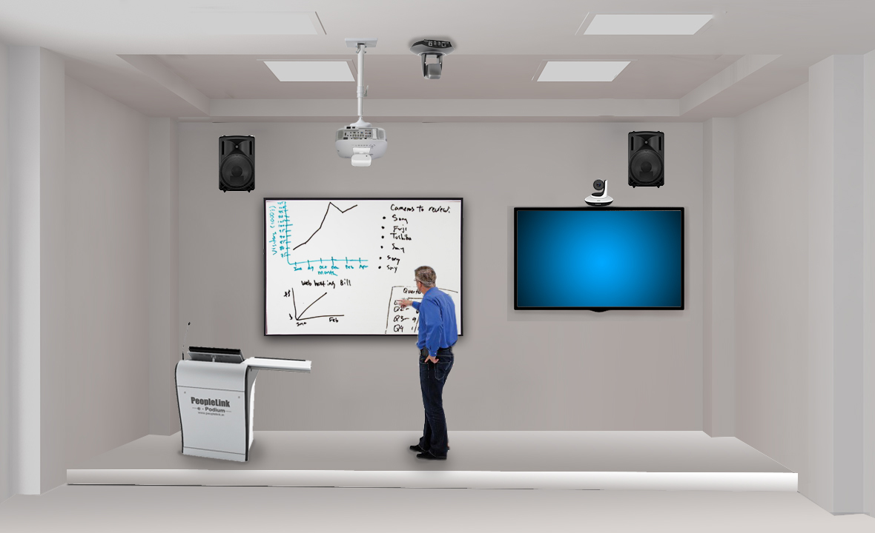

SMART CLASS ROOM SOLUTION
Comprehensive smart classroom deployment covers all aspect of in class education.
Digital podium with inbuilt tablet PC and
IOT controller allows to manage the ambience and the presentation right for the podium.
Lock & track camera moves to track the lecturer’s movement in the class.
Connected speakers enhance the audio experience of the classroom
Video Learning Management System not only make the class more engaging with interactive tools. It has the features of :
Connecting multiple classes. The lecture could be streamed to multiple locations and be remotely managed.
Content and assignment are delivered online to standardize the teaching delivery.
Each class can be recorded and stored centrally

Slide 9

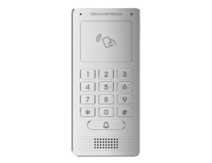
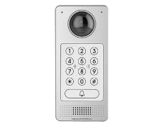







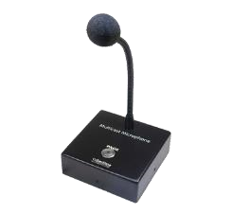
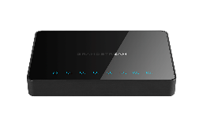

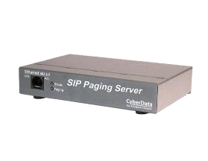



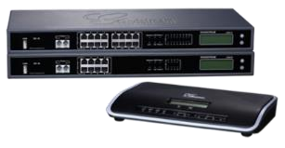
IoT & SIP BASED SOLUTION
BSRA
Technical Consultant & Services
SIP Voice & Video
Door Intercoms
ATAs
& Gateways
Product and Solutions offered are
Unified Communication Platform with Video / Chat/Document Transfer/Video Bridge
IP End Points -Audio and Multimedia
Industrial and Flame Proof IP End Points
IP -Paging-SIP & Multicast
IP-Surveillance-SIP/AI/LPR-4K
Network Switches-Weather Proof/Long Range/ Industrial
Business Conferencing-Premise-Cloud & Hybrid
Personal Collaboration
Contact Centre Application with Social Media Integration /CRM
Networking
Solutions
SIP Paging
& Accessories
H.265+ SIP
Surveillance & PoE NVRs
UCM with
Video Conferencing

Slide 10
AI BASED CYBER SECURITY SOLUTION
FOR SMART & SAFE CITY
Incident Detection
Monitor social media platforms expressing concerns or issues
Use images to detect visual anomalies that may indicate danger or criminal activity
Detect Criminal or Public Safety Issues.
Analysis
Analyse, identify the cause and Source for informing the relevant law enforcement agencies
In depth Investigation using AI Platform for fast & reliable analysis results.
Response
Resolve the problem or threat using deep, actionable insights
Alert Mechanisms & Watchlists / Databases for better law enforcement action
Strategic Prevention for enhancing Public Safety using AI Platforms

Slide 11
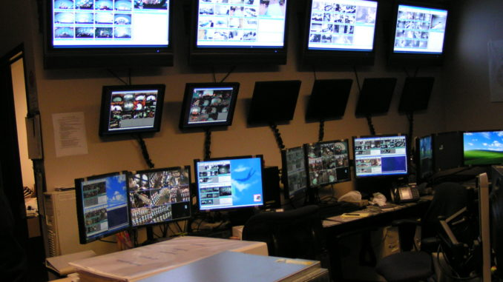



SMART & SAFE CITY SOLUTION
Command and Control Centre
Applications
E Governance
Communications
Public Utilities
Environment
Smart Building
Smart Transport/Parking
Surveillance
Health care
Helpline/
Emergency
Education
IoT Platforms
Energy
Network
IaaS
PaaS
SaaS
Wired
Optical Fibre
Copper based
Cable
Wireless Long range Licensed/Open
2G/3G/4G
LTE
5G
Wireless Shortrange Unlicensed/Open
WIFI
Bluetooth
Things
Smart Surveillance
Smart Healthcare
Smart Transport
Smart Environment
BSRA Provides Applications and Program management for the Smart & Safe City

Slide 12
SERVICES
  Annual Maintenance Contract (Software & Hardware)
  Installation &
  Commissioning
  Data Centre planning and Implementation
  Project Management & Implementation
  Training
  Training
  Voice & Data Networking

Slide 13






OUR TECHNOLOGY PARTNERS
BSRA
Technical Consultant & Services
Prime Digitronics Services Pvt Ltd

Slide 14
Contact us
Call Us +91 9910381041
+91 8884899914
Write to us @ sales@bsratech.com
bsra.technology@gmail.com
LinkedIn https://www.linkedin.com/in/bsra-technical-consultancy-and-services-llp-1071651ba/
Website https://www.bsratech.com

